Slide 1
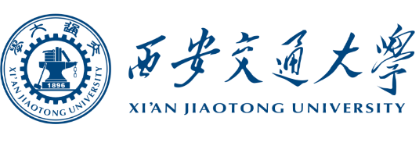
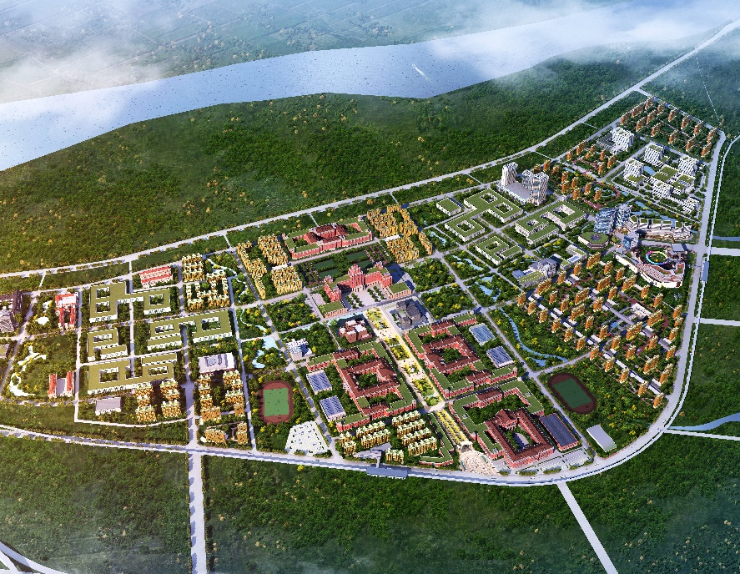
The introduction of the campus network of Xi 'an Jiaotong University
Network Information Center：Bo She

Slide 2
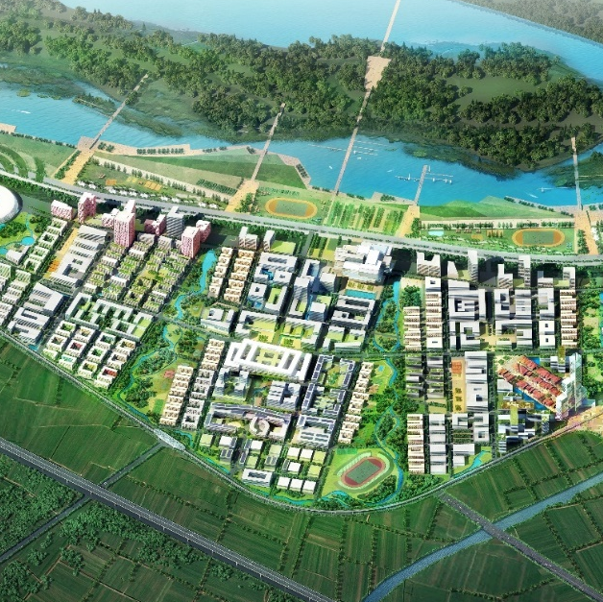
01
Basic Information of the University
02
Basic Information of the Campus Network
Outline
03
Current Issues and Considerations
04
Campus network construction vision

Slide 3
一、Basic Information of the University
Xi'an Jiaotong University currently has four campuses: Xingqing, Yanta, Qujiang, and Western China Science And Technology Innovation Harbor, covering an area of approximately 4658 mu (around 310 hectares) with a total construction area of approximately 4 million square meters for various buildings.
The university comprises 31 colleges (departments, centers), 9 undergraduate schools, 3 directly affiliated hospitals, an affiliated kindergarten, and affiliated primary/middle/high schools. Currently, there are 6,635 faculty members on staff, including 3,789 full-time teachers. The university has a total enrollment of 54,760 students, including 22,407 undergraduate students, 29,285 graduate students, and 3,068 international students.。
In addition, the university also has residential areas in Xingqing and Yanta campuses, with a total of over 130 buildings and more than 10,000 households.

Slide 4
二、Basic Information of the Campus Network
Since 1999, our university has been providing campus network services to teachers and students. Currently, we have established a converged network that integrates wired, wireless, Internet of Things (IoT), and 4G/5G technologies. This converged network forms a 100G high-speed ring network across our four campuses, with 100G/40G/10G access into each building, and gigabit/megabit speeds directly to desktops. The total export bandwidth of our campus network reaches 50GB.
multi-service ：Wired, wireless, Internet of Things (IoT), 5G, high-performance computing, classrooms, campus card, and more than 20 other dedicated networks for various services
Bandwidth 50GB ：Multi-operator lines (education network, mobile, telecom), to protect 70,000 teachers and students online teaching, research, study, life, etc.
100% wired coverage： Fiber optic cables reaching every building, 1000M/100M speeds to desktops, over 50 core switches, than 5,000 aggregation and access switches, and over 100,000 information points.
100% wireless comoreverage：Over 30,000 Access Points (APs) across the four campuses, with concurrent terminal devices exceeding 100,000
High-speed interconnection between the four campuses: 100G high-speed interconnectivity between the cores of the four campuses.

Slide 5
二、Basic Information of the Campus Network
Campus network services provided for teachers and students
Wired/Wireless
VPN
Library Electronic Resources
High Performance Computing
Cloud Platform
Mail
One-card
Dedicated Network
IoT
Network Security
Domain name/fixed IP address
Server Hosting

Slide 6




二、Basic Information of the Campus Network
Network Topology Diagram of the Four Campuses
China Mobile
China Telecom
China Mobile
China Telecom
CERNET
Specialized Network
Specialized Network
Innovation
Harbor
Export
Xingqing Campus
Smart Classrooms
Smart Classrooms
SDN Controller
Export
One-card
Data Center
High-Performance Computing Center
Innovation
Harbor SDN Core
Xingqing Core Switch
High-Performance Computing Center
Xingqing SDN Core
Innovation Harbor Data Center
Xingqing
Data Center
SDN+VXLAN
Innovation
Harbor Wired and Wireless Networks
User Network
Xingqing Campus
Wireless Network
Xingqing/Yanta/Qujiang Campus Wired Network
User Network
Yanta SDN Core
Qujiang SDN Core
Yanta Campus Wireless Network
Qujiang Campus Wireless Network

Slide 7
二、Basic Information of the Campus Network
Serial number | Indicator |  | 2024
1 | Network infrastructure | Total campus network export bandwidth (bps) | 50G
2 |  | Per capita campus network export bandwidth (bps) | 815K
3 |  | Campus network trunk interconnection bandwidth (bps) | 40G/100G
4 |  | Number of wireless access points (APs) | 3万
5 |  | Number of concurrent online devices on the campus network | 20万
6 | Public platform | Public high-performance computing capability (in teraflops) | 1500
7 |  | Data storage capacity (in petabytes) | 6
8 |  | Data center floor area (in square meters) | 4800
9 |  | Percentage of routine course recording and broadcasting (%) | 100%
10 |  | MOOC resources (number of courses) | 200

Slide 8
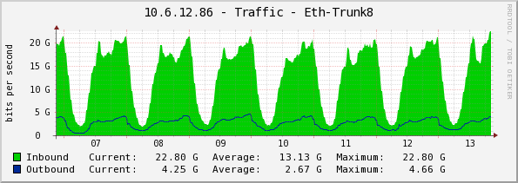
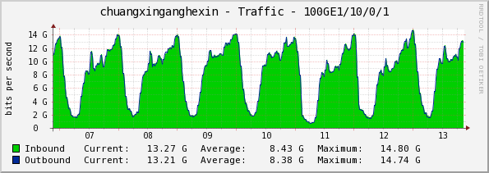
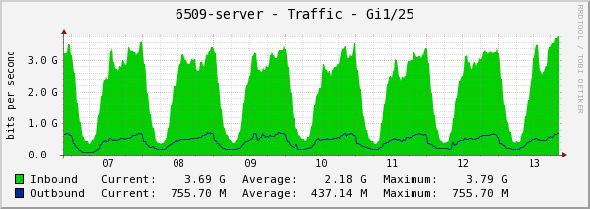
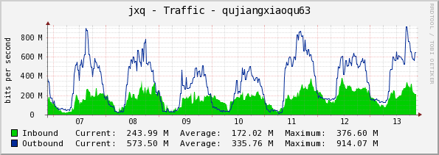
二、Basic Information of the Campus Network
Video : 3.2%
QQ and WeChat: 3.4%
Online games: 1.1%
Mobile applications: 6.7%
Total traffic in Xingqing campus, peaking at 23G
Total traffic in the Western China Science And Technology Innovation Harbor campus, peaking at 15G
Download traffic: 7.9%
Website visits: 44%
System updates, email, DNS, remote connections, etc.: 34.8%
Total traffic in Yanta campus, peaking at 4G
Total traffic in Qujiang campus, peaking at 1G
Peak traffic chart for each campus
Web access remains the most popular application, followed by video downloads, mobile applications, and others.

Slide 9
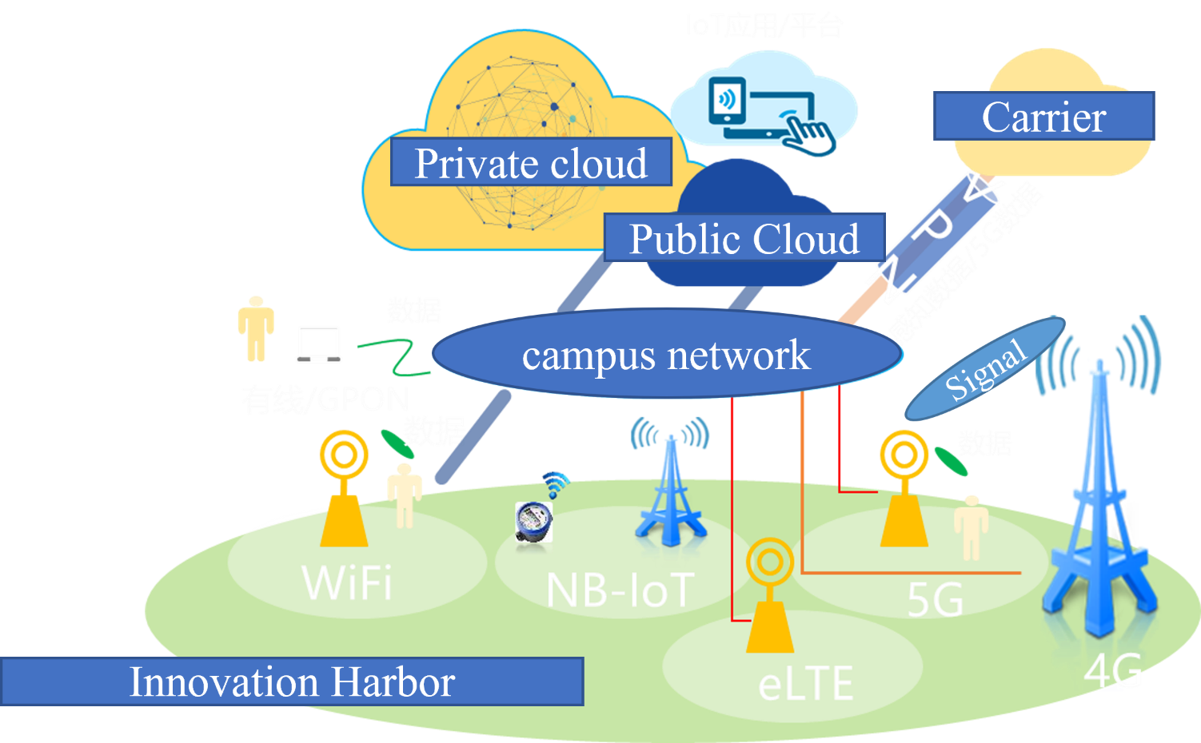
二、Basic Information of the Campus Network（Innovation Harbor）
Achieve the "four-network convergence" of wired, wireless, Internet of Things, and 5G networks, creating a fundamental network service with high bandwidth, high availability, full business support, intelligent services, integrated operation and maintenance, and comprehensive prevention and control.
Four-Network Convergence
01
Full Coverage of Wired Networks：Backbone optical fibers and multiple edge access methods to meet external export and graded security requirements.
Full Coverage of Wireless Networks：WiFi access from multiple operators; eLTE command-specific network.
IoT Applications Across All Scenarios： Integration of NB-IoT and edge gateways for unified access and sensing interaction of physical devices.
4G/5G Network Coverage：Comprehensive construction of base stations, integrated into the landscape system
02
03
04
Unified Access, Unified Control, Unified Service, and Unified Experience

Slide 10















二、Basic Information of the Campus Network（Innovation Harbor）
Innovation Harbor Topology Diagram
Campus Two
Campus Three
Wired Network: 28 core switches, 100G VXLAN+SDN network, 1,423 wired access switches，100G Wavelength Division Multiplexing (WDM) Ring Network Interconnection, reliable, flexible, redundancy and scalability.
Wireless Network: 608 POE switches, 2,735 IoT APs, 856 high-density APs, 7000 panel Aps and 265 outdoor APs, high-speed, full coverage.
IoT: 105 AR169/713 AR502 IoT gateways and 2,735 IoT APs，various IoT terminals.
Integration: Integration of Wired, Wireless, and IoT Networks with Unified Access, Unified Control, Unified Service, and Unified Experience。
Security: Firewall, traffic cleaning, unknown threat protection, security situation awareness, comprehensive network protection.
Campus One
Cernet
WDM Transmission
CN/..
Internet
SDN Controller
AAA
NMS
Data Center
BRAS
Internet Behavior
Management
Sandbox
DDOS
ISP1
Internal Network Security Resource Pool
Border
Fabric
出口FW
ISP2
Edge
Edge
……
Building1
Building2
Building3
Building4
DormitoryA
DormitoryB
DormitoryC
DormitoryD
LB
Awareness
Virtual Reality
IoT
PC
Smart Terminal

Slide 11
三、Current Issues and Considerations
SDN/VXLAN Technology
1、 SDN/VXLAN technology has a high technical threshold, and operation and maintenance require a high level of technical proficiency and extensive operational experience. Locating problems with SDN/VXLAN can be difficult, and most universities do not have the professional technical teams to support it.；
2、Compared to traditional networks, implementing an SDN/VXLAN architecture carries a higher cost. Due to cost considerations, many universities choose to manage only up to the aggregation switches with their SND, leaving the access switches unmanaged. This approach does not fully leverage the capabilities of SDN；

Slide 12
三、Current Issues and Considerations
SDN/VXLAN Technology
3、The network scenarios in universities are complex, and many of them are not suitable for SDN/VXLAN. This includes small local area networks in laboratories, campus card networks, and various dedicated networks. Additionally, using SDN/VXLAN for networks involving sensitive data or critical business operations significantly increases security risks.；
4、Universities often have a variety of different devices, and SDN controllers may not be compatible with equipment from other vendors. Choosing an SDN/VXLAN solution often means being tied to a single vendor.

Slide 13
三、 Current Issues and Considerations
Wireless Network Issues
1、Difficulties in Coverage and Signal Stability: The large campus area and complex building layout, especially within large structures such as libraries, teaching buildings, and megastructures, pose challenges. There are numerous wireless devices installed in these buildings, such as small routers, as well as outdoor factors like terrain and vegetation.
2、 Severe Wireless Usage Tide Phenomenon: The tide phenomenon is particularly evident during class changes, exams, and various events in universities. Proper planning for wireless network redundancy is crucial as the tide phenomenon can have a significant impact on the stability of the entire wireless network.

Slide 14
三、 Current Issues and Considerations
Wireless Network Issues
3、Poor Wireless Network Roaming Experience: Issues such as dense deployment of APs, overlapping and intersecting signals, wireless interference, the impact of the tide phenomenon on wireless devices, and incompatibility between different vendor brands can all contribute to a poor roaming experience.
4、Significant Differences in Wireless User Perception: Factors like personal device capabilities (wireless protocols, negotiation rates, etc.), usage locations, and usage habits can lead to varying perceptions of wireless network quality, making it difficult to establish a unified evaluation standard.
5、Challenges in Wireless Authentication: Universities have a complex personnel structure and require multiple authentication methods, including seamless authentication and visitor authentication, which can be difficult to implement.

Slide 15
三、Current Issues and Considerations
User Server/Printer Management
1、Challenges in Deploying Printers/Servers: Difficulties arise in implementing real-name registration, binding IP addresses/ports/MAC addresses, meeting diverse service requirements, and developing access restriction policies.
2、Severe Network Security Issues: Most servers are managed by users themselves, resulting in inadequate protective measures on the servers and prominent security issues.

Slide 16
三、Current Issues and Considerations
Utilization of Campus Network Export Bandwidth
1、Currently, campus networks have multiple export lines, including those provided by China Mobile, China Unicom, China Telecom, and CERNET (China Education and Research Network). There are difficulties in optimizing the utilization of bandwidth and network path selection. Therefore, there is an exploration of applying SD-WAN technology to the network exports of universities.

Slide 17
四、Campus network construction vision
Efficiency: The network architecture is simple and easy to use, with various network devices and systems highly integrated. Unified management is achieved through a centralized management platform, enabling real-time monitoring, fault warning, and automatic repair of network devices through an intelligent management system.
Security: Establish a comprehensive, multi-layered, and highly effective security protection system, coupled with a robust security management system and emergency response mechanism.
Convenience: Simplified device access authentication, a one-click service experience for users, and personalized service customization.
Intelligence: Utilize advanced technologies such as artificial intelligence and big data to achieve intelligent scheduling of network resources, intelligent diagnosis and repair of faults, and intelligent analysis of user behavior.

Slide 18
Thank You

